Slide 1
Kyle Field

Slide 2
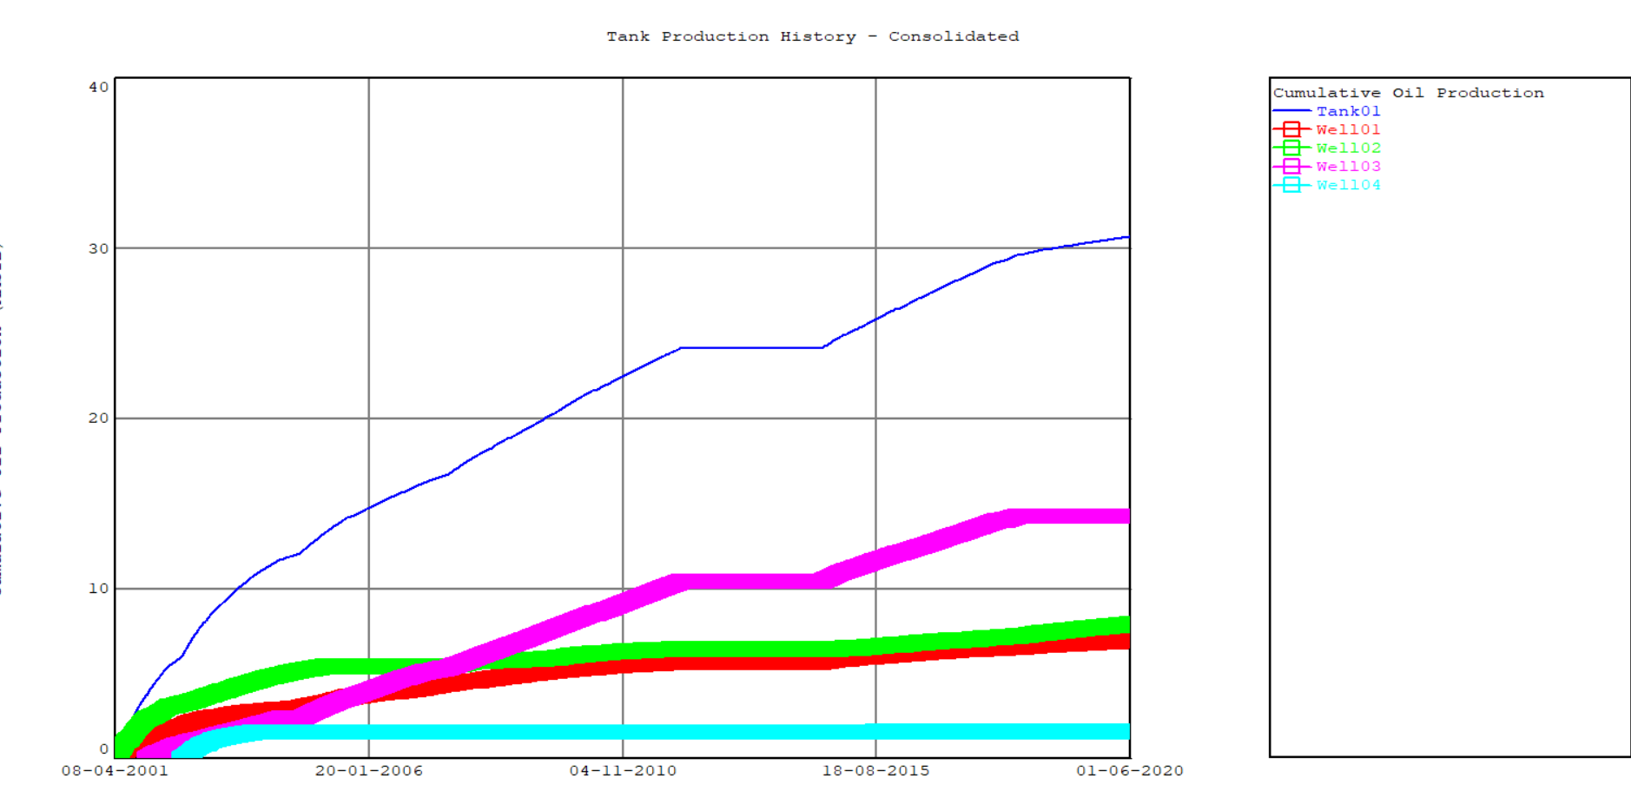
Field Production History

Slide 3
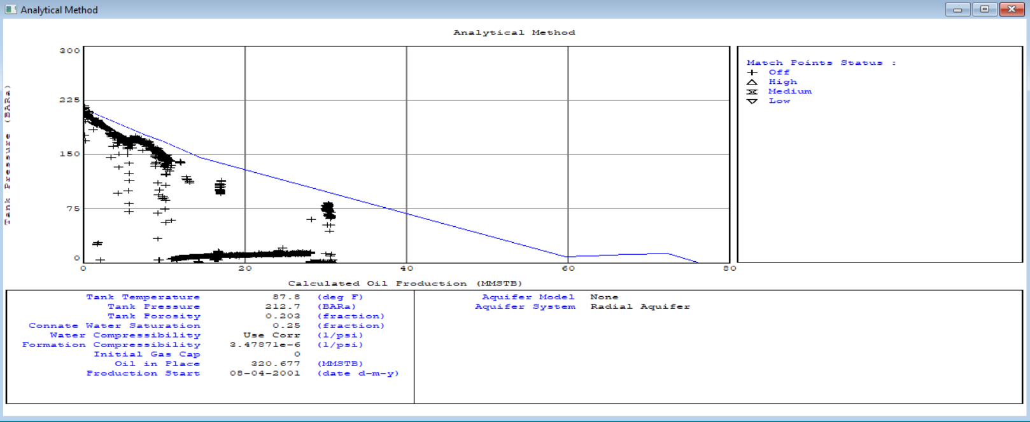
ANALYTICAL PLOT

Slide 4
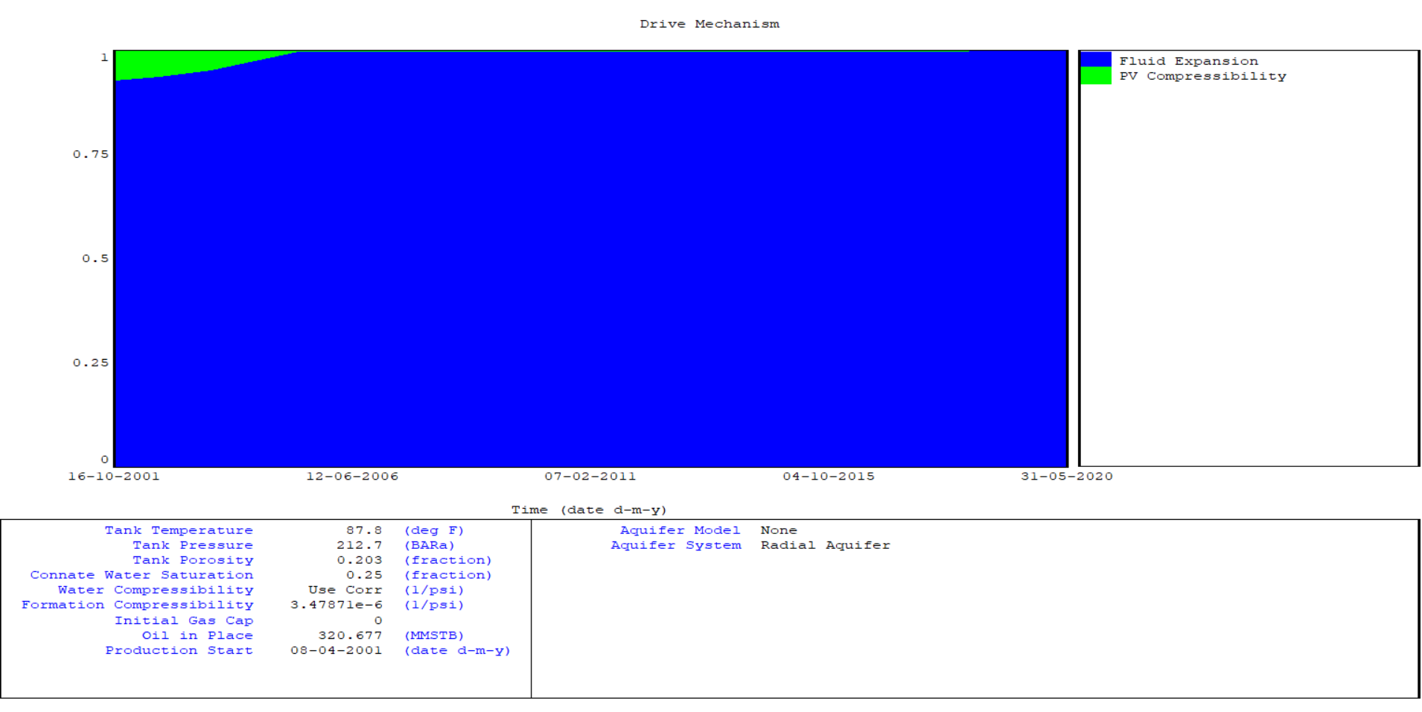
Drive MECHANISM

Slide 5
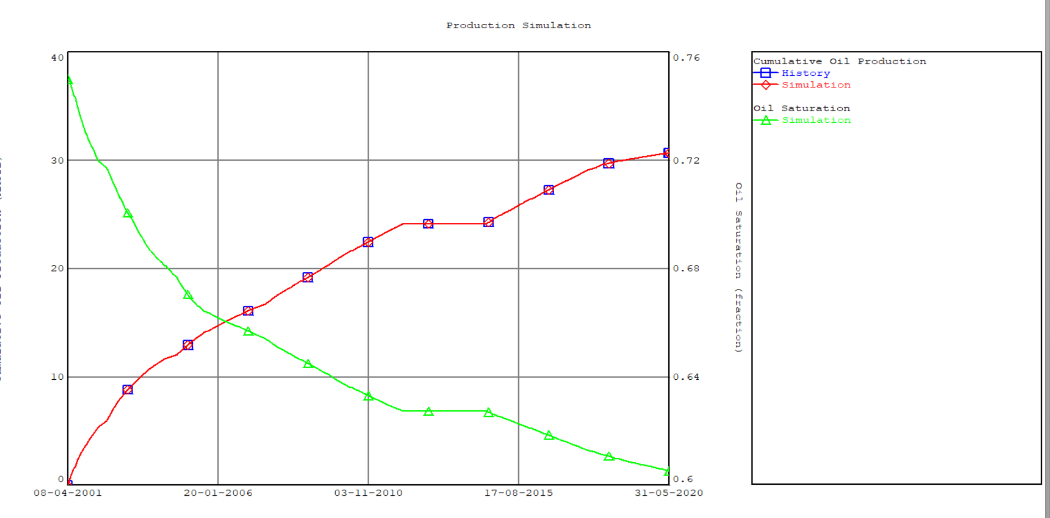
Production Simulation

